Slide 1
New Technology, New Ways of Thinking (& Doing)
Robin Fay, rfay@athenstech.edu
@georgiawebgurl

Slide 2
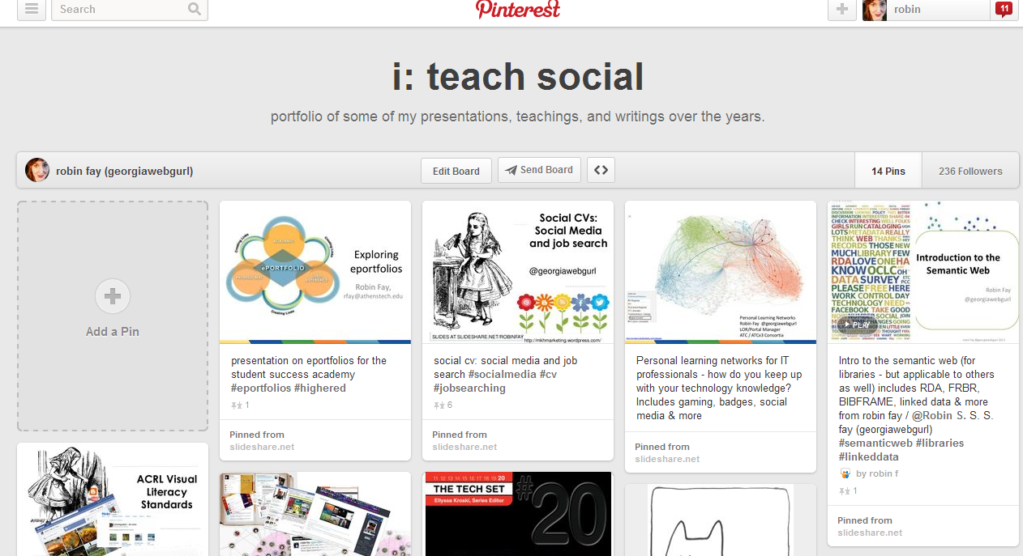
Quick bio
15+ years in technology and libraries
Projects include metadata, technology, and web work for nonprofits, libraries, and corporations
Teacher/Trainer
@georgiawebgurl
Robin Fay @georgiawebgurl

Slide 3
More about this project
TAACCCT Trade Adjustment Assistance Community College & Career Training
Funded by the US Department of Labor
$2 billion over 4 years
All courseware openly licensed (CC BY)

Slide 4
More about this project
ATC Times Three (ATCx3) Consortium, a collaborative effort involving Albany Technical College, Athens Technical College, and Atlanta Technical College, is working to increase access to and completion of associate degree programs in engineering technology.
To meet the needs of the TAACCCT Grant, consortium members are developing an integrated strategy that incorporates stacked and latticed credentials, transforms instructional delivery, and provides students with “wrap around” support services, including a Learning Objects Repository (LOR) and Portal website.

Slide 5
Discussion
How many of us have shared some form of media online?
How many of us have put some form of educational media online?
Do you consider how the content you share online is licensed for use by others?
How many have heard the term open educational resources?
Robin Fay @georgiawebgurl

Slide 6
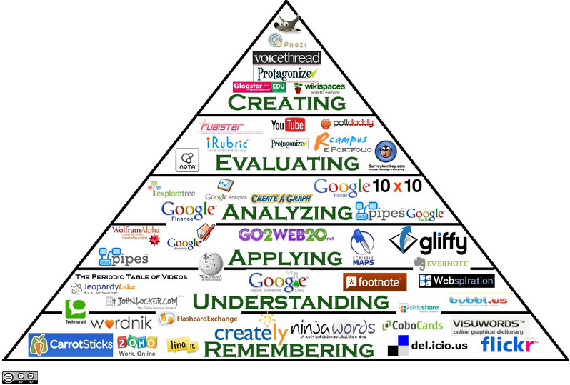
Discussion
Robin Fay @georgiawebgurl

Slide 7
Open everything & other trends: big trends
Technology
Mobile
Touch
3D and more
Multiple screens
Data driven (big data) We leave digital trails wherever we go: sometimes these are markers (cookies, search history, GPS, bank transactions, receipts, etc.), created by machines; other times it is content that we create (posts on social media, Amazon reviews, etc.) or others create about us. Sometimes both! Check-ins at foursquare are both markers and content. (Metadata, btw)
Robin Fay @georgiawebgurl

Slide 8
Open everything & other trends: big trends
Human :
More visual learners
Collaborative
Social
Share
More DIY (Makerspaces)
Customized/Personalized for us (thanks metadata!)
Privacy
Identity
Robin Fay @georgiawebgurl

Slide 9
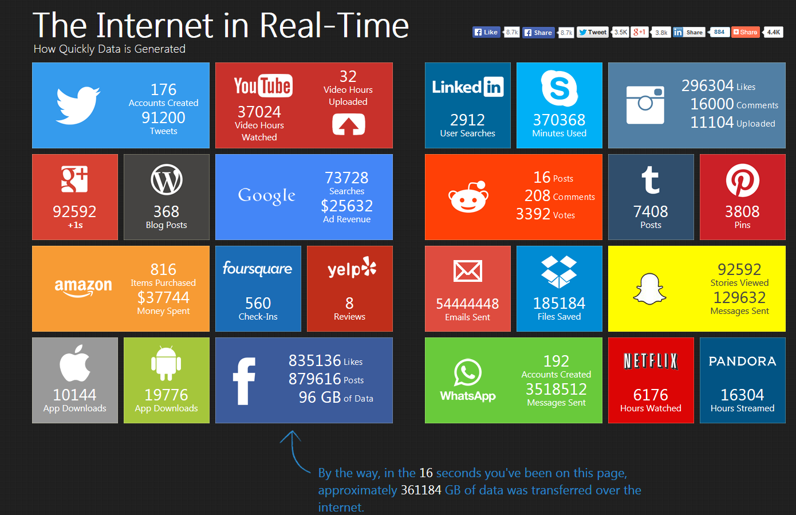
How much data? The internet in realtime – 5/28/2014 4:30PM http://pennystocks.la/internet-in-real-time/
Robin Fay @georgiawebgurl

Slide 10
What is OER
Open Educational Resources :
Any kind of teaching materials – textbooks, syllabi, lesson plans, videos, readings, exams even classes (think MOOCS, but not all!)
Robin Fay @georgiawebgurl

Slide 11
Open is…
Open even goes beyond just resources – sharing data (open data), sharing manufacturing (open manufacturing), sharing software (open source)
Robin Fay @georgiawebgurl

Slide 12
Open is…
Open even goes beyond just resources – sharing data (open data), sharing manufacturing (open manufacturing), sharing software (open source)
Robin Fay @georgiawebgurl

Slide 13
The Khan Academy

Slide 14
Copyright
© Cancels the Possibilities
Of digital media and the internet
Internet Enables
Copyright Forbids
Wiley, D. (2012) Openness and the Future. ETS Future of Assessment Conference. Presentation available: http://www.slideshare.net/opencontent/openness-and-the-future-of-assessment

Slide 15
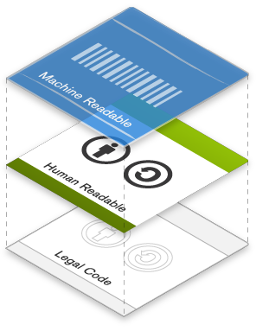
Copyright
Legal and Technical
Legal Code, Human Readable Deed, Meta-Data
http://creativecommons.org/licenses/

Slide 17
Open Educational Resources
Open Content / Open educational resources (OER) / Open Courseware are educational materials which are discoverable online and openly licensed that can be:
Shared freely and openly to be…
… redistribute and share again.
Shared
Redistributed
Used
… used by anyone to …
… adapt / repurpose/ improve under some type of license in order to …
Improved
Notes:
The key aspect of an OER is that it is both discoverable online – so that people can find it AND openly licensed - so that people can legally make use of it. OER includes texts, different forms of media, ideas, as well as documented teaching strategies/techniques or practices.
Advocates of openness would suggest that the value in OER is in its potential to support learning in many ways and in many contexts.

Slide 18
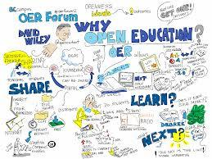
Notes:
The key aspect of an OER is that it is both discoverable online – so that people can find it AND openly licensed - so that people can legally make use of it. OER includes texts, different forms of media, ideas, as well as documented teaching strategies/techniques or practices.
Advocates of openness would suggest that the value in OER is in its potential to support learning in many ways and in many contexts.

Slide 19
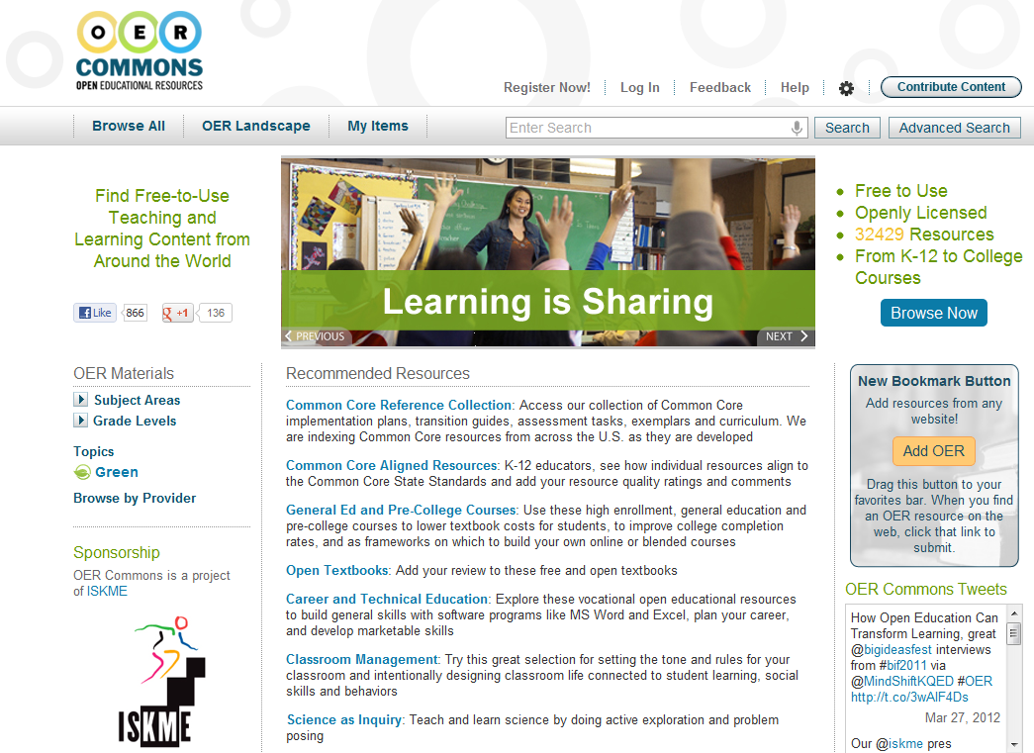
Aggregating content: OER Commons

Slide 20
Discussion:
What do you see as emerging trends?
Challenges?

Slide 21
How do these technologies impact libraries
Libraries as
Community space
Community partners – job training, health care / ACA partners
Hackspaces
Makerspaces & Labs
Incubators/startups
Technology hubs
Technology

Slide 22
Resources
Open Educational Resources open4us.org/
Merlot http://www.merlot.org/
NTER https://www.nterlearning.org/
Wiselearn http://wiselearn.dpi.wi.gov/wi-digital-learning-open-education-resources
College Open Textbooks http://www.collegeopentextbooks.org/
Orange Grove http://florida.theorangegrove.org/og/access/home.do
GALILEO / Affordable Learning / GA Textbooks http://www.affordablelearninggeorgia.org/
OER Commons https://www.oercommons.org/
Khan Academy https://www.khanacademy.org/
Open Yalehttp://oyc.yale.edu/
North Carolina LOR http://www.nclor.org/nclorprod/access/home.do
Washington k-12 but may be of interest for Sci/English/Math skills
https://digitallearning.k12.wa.us/oer/library/
https://www.oercommons.org/

