Slide 1
Go Google

Slide 2
Google
Overview of Google products
Drive, Docs, Forms & more
Getting started
Productivity tips
Collaboration
Storage
Using Google on other devices
Cheat sheet handouts – Shortcut keys, search tips, etc.

Slide 3
Go Google
… is software and web based tools
Search
Web search (google.com, a search engine – web based)
Chrome (web browser - software)
Advanced searching and niche searching (images, etc.)
Communication
Gmail (email)
Discussion groups – Google groups, hangouts
Hangouts – live/scheduled meetups on line similar to conference calling
IM (Google chat) – being replaced by hangouts
Google Talk (get your own Google phone #)
Translate

Slide 4
Google
Cool things & projects
Google Earth
Google Glass
Panoramio – share your images with the world via Google Maps
Google Loon (project to use weather balloons for wifi)
Trends – what’s trending
Google Fiber (fiber optics & lots of other things)
Google’s self driving car
Images + Video + Music!
Picasa
Google Play / Music

Slide 5
Google
Mobile
Android
Google drive
Ask Google (Voice activated help)
Other products they have purchased
Youtube
Blogger
Feedburner (works with blogs and rss feeds)

Slide 6
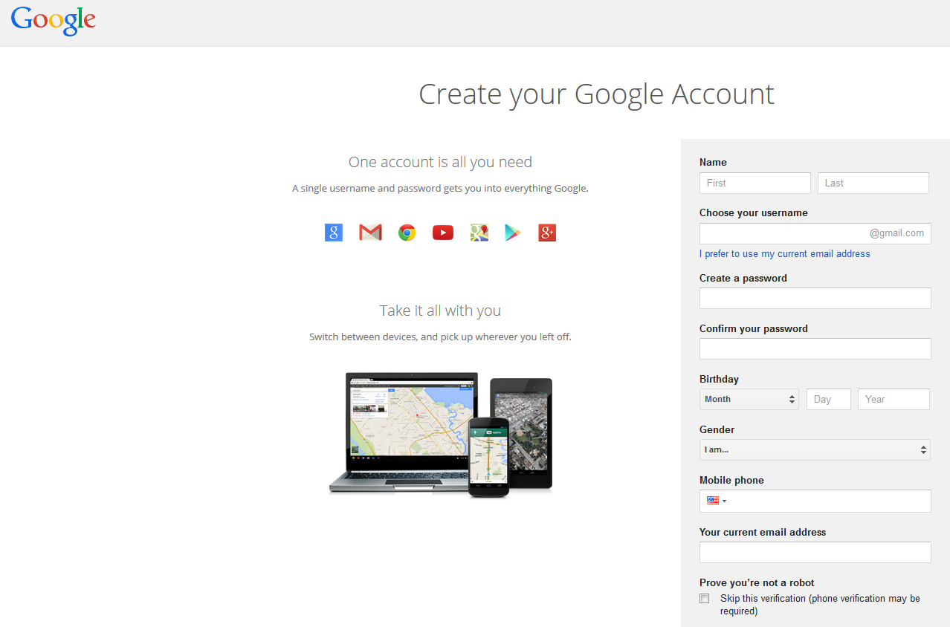
https://accounts.google.com/SignUp

Slide 7
Drive
Free storage up to 15GB excludes youtube
Can upload pdfs, office and openoffice formats which can be edited online (Google Docs) ; can download, too!
Can share documents and work collaboratively (even with non Googlers)
Mobile friendly; cloud based
Downloadable product also.
Create a Google account – if you have a GMAIL, Youtube or Blogger account, you have a Google account

Slide 8
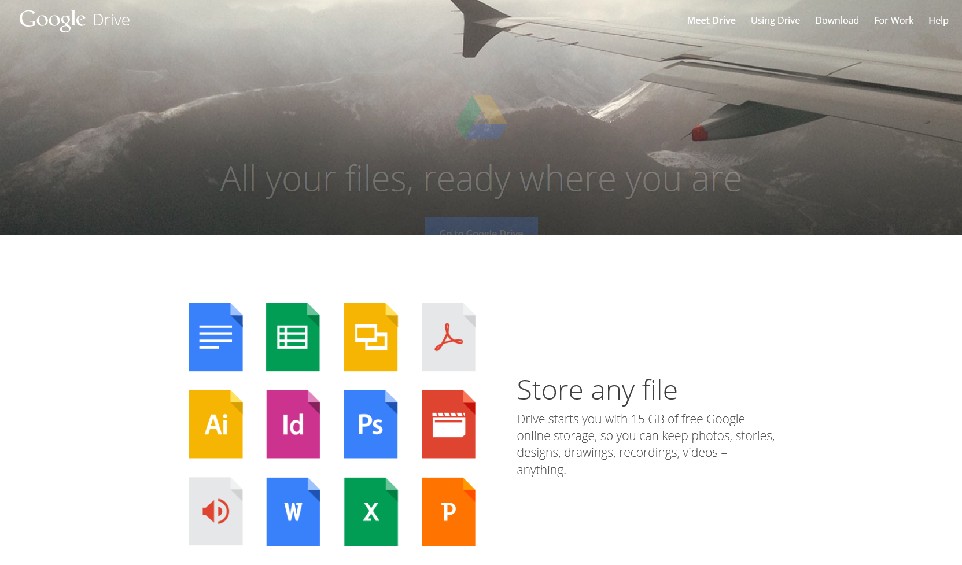

Slide 9
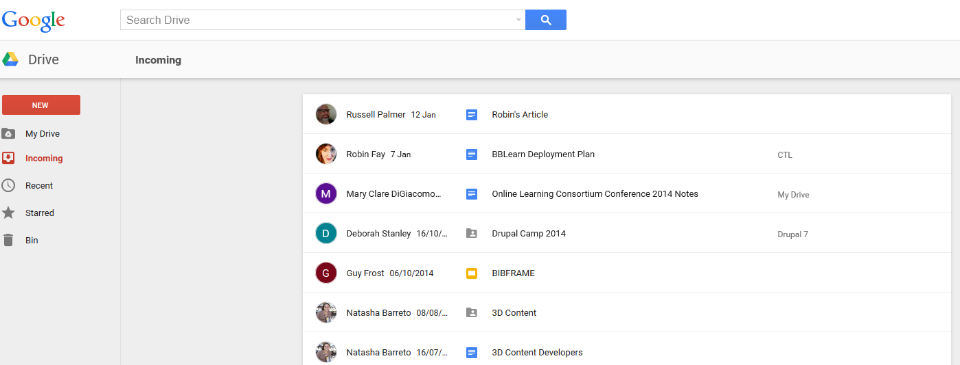
Drive
Let’s take a look at organization, searching, sharing a folder, uploading/converting document - Live Demo covers slide 10-14

Slide 10
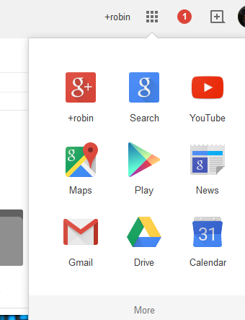
Other products…

Slide 11
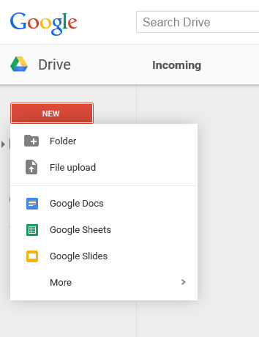
Drive
Upload files and folders
Create folders to organize
Create new Google doc by type – will open window

Slide 12
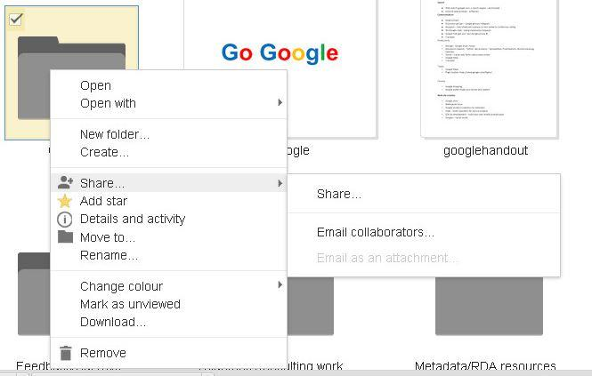
Drive
Sharing a folder

Slide 13
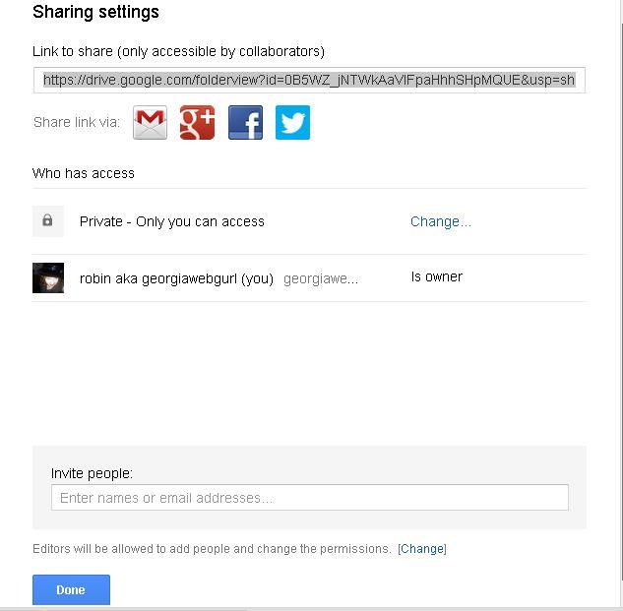
Drive
Sharing a folder
These apply to files too except you have more options - we’ll cover files in Docs

Slide 14
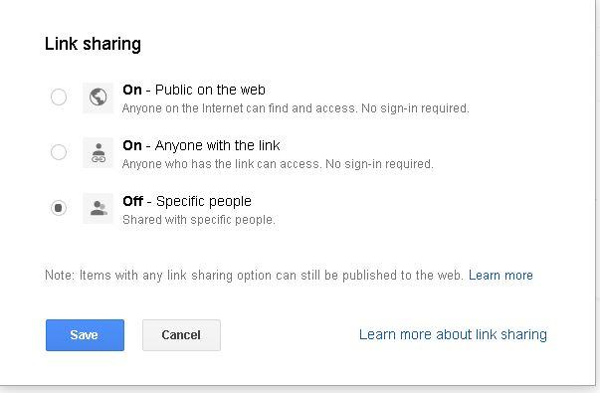
Drive
Sharing options

Slide 15
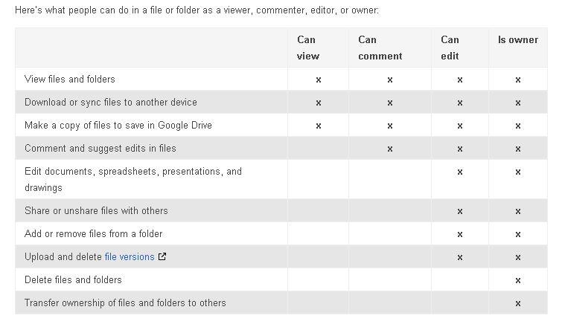
Drive
You can also choose what people can do

Slide 16
To Upload a file:
Select ‘upload’ then ‘files’.
Choose your file from your computer.
Select ‘convert’ to Google Docs format.
Start upload. Once it is uploaded it will be converted to a Google Docs format and you edit via the Google Docs editor. (You can also create new, too!)

Slide 17
Docs
Free, web-based application (cloud)
Create, share and manage documents (docs).
Can share documents and work collaboratively (even with non Googlers)
Productivity tools including Word Documents (letters, flyers, essays; similar to Microsoft Word documents) ; Spreadsheets (similar to Microsoft Excel worksheets); Presentations (Creation and presentation slides similar to Microsoft PowerPoint slideshows).
Also:
Forms: For collecting and organizing data (Create>Form).
Drawings: For creating simple vector graphics or diagrams. (Create>Drawing)

Slide 18
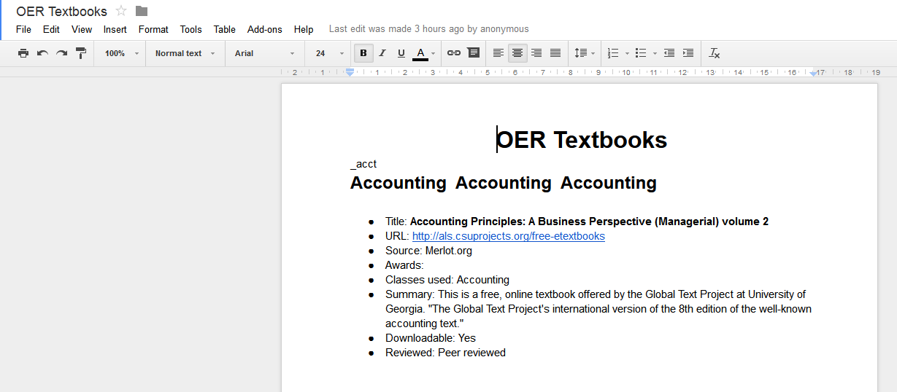
Docs
Notice the toolbar is similar to the word processors.
Live demo: Edit file, create a file, move to folder, share, publish to web, embed, show revision - slides 19-23

Slide 19
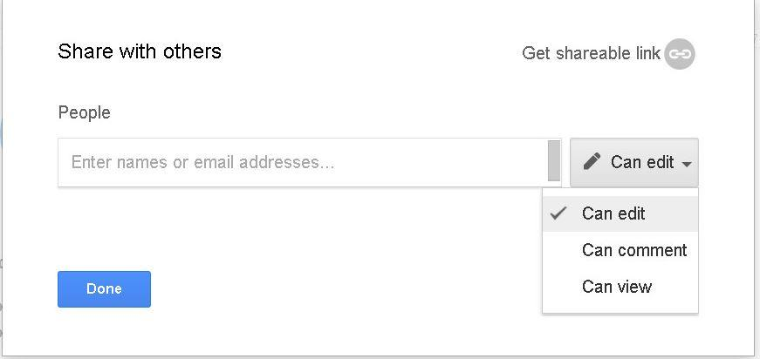
Google Docs

Slide 20
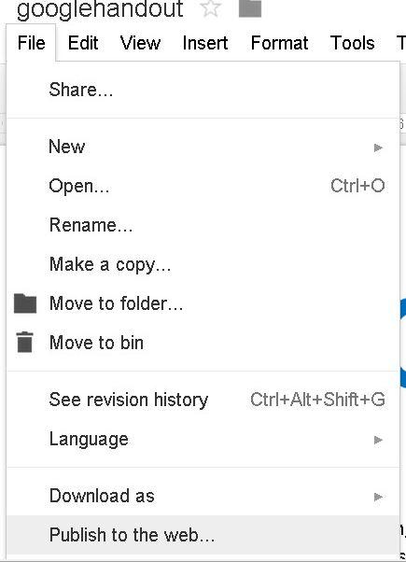
Google Docs

Slide 21
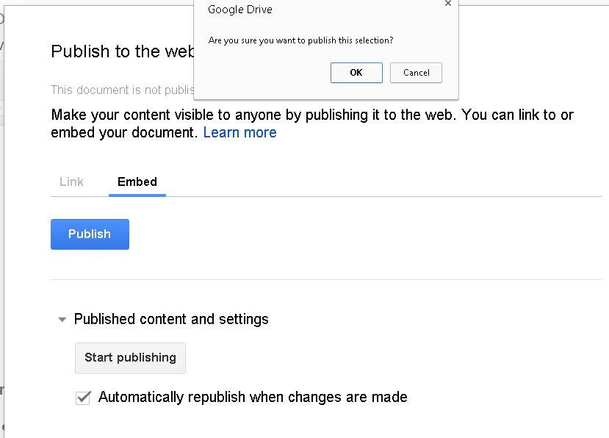
Google Docs
Can be pushed into social media, embedded in blogs, etc.

Slide 22
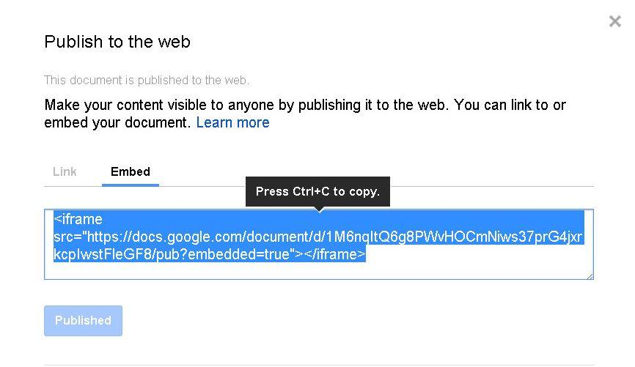
Google Docs

Slide 23
Google Best practices
Best practices:
Give a descriptive title - it makes it easier to search and find
When sharing a doc, send an email message to notify those you are sharing with. Use their GMail address unless they ask otherwise.
If you have trouble accessing a shared document, make sure to check the email address used for you. (If you are signed in under a different account, you will not be able to access it)
Starring documents can make them easier to find
Formatting can get lost between Microsoft Office and Google Docs
Don’t forget about Spreadsheets, Presentations (like this one) and forms

Slide 24
Google Best practices
Revision history and the Bin
When you delete in Google Drive, it moves it to a temporary trash (BIn) for 30 Days. You can recover it at any time prior to that. It also holds revisions (the last 100), so you can restore from that as well
You can turn off autodeleting of revisions under Manage Revisions.
Revisions: Ctrl + Alt +G or Edit>Revision History
To archive/download everything: Click on All Items (multiple ways to get there) or select all and download.

Slide 25
Google Collaboration
Use Google Docs to:
Work together on a document (keep it draft until complete); Revisions can be tracked, too!
Take live collaborative notes at a conference
Easily share conference notes, class materials, or other items with others
Publish to the web OR provide a private link that only some people can see
Store your files and get an embeddable link for use – social media and elsewhere
Store and edit videos (transcription too!) - Youtube
Create a blog, survey, or drawing
Backup and storage up to 15G
Access shared docs from anywhere with internet

Slide 26
Google Groups
Google’s version of an online discussion group, similar to a LISTSERV.
You can create them or just participate. They can be closed or public.
Topics can contain multiple posts. Posts are replies from readers to the topic.
They are searchable and archivable.

Slide 27
Google Forms
Create forms, surveys, invitations, signup sheets (send out via email or embed in a site)
Results are automatically posted in a spreadsheet
Run reports and create graphs (can be embedded in a doc)

Slide 28
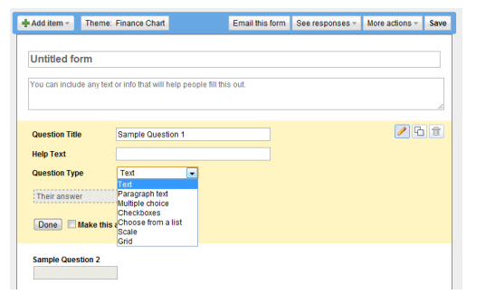
Google Forms

Slide 29
Google Sites
Create websites through a guided process, which can include embedded Google docs, blogger posts, rss feeds and more. FirstYear seminar portfolio is a simple Google Site template.
Can be private, public, or shared with select individuals. Templates are always public.
Can be used to organize resources, create pathfinders, and other projects.

Slide 30
Let's look at Google+
Google +
Have a social media presence
More control than facebook - can be as public or private as you want
Rather than friends, “circles” or groups of individuals
Has pages for organization and community groups
Can easily share email, blogs, links, and more.
(... what is it?)

Slide 31
http://plus.google.com

Slide 32
What is Google+?
News feed
Your friends
Circles
Notes:
Latest SM platform offering a series of tools to help you connect with the people your network. It has features that are similar to what you find in facebook, but with different names. Stream = News Feed

Slide 33
Posts are shared with different levels of privacy...
... you choose

Slide 34
Hangouts are replacing Chat (IM) - don’t worry, it’s transparent…

Slide 35
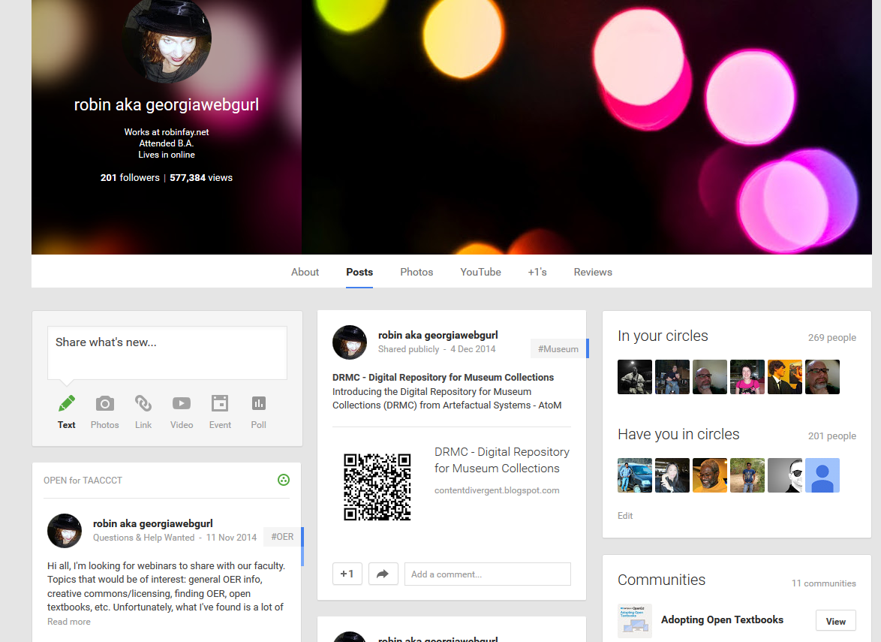

Slide 36
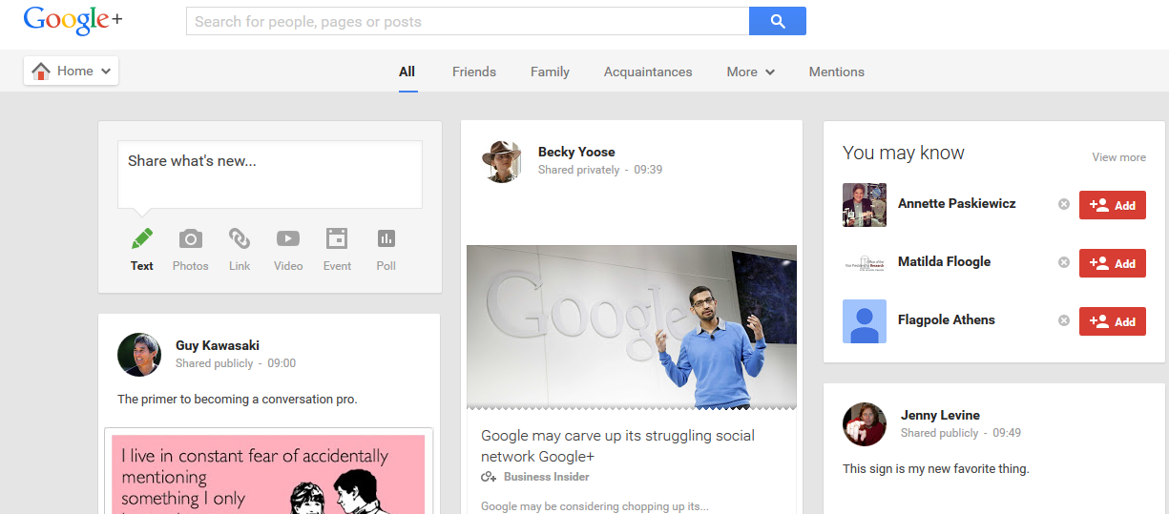

Slide 37
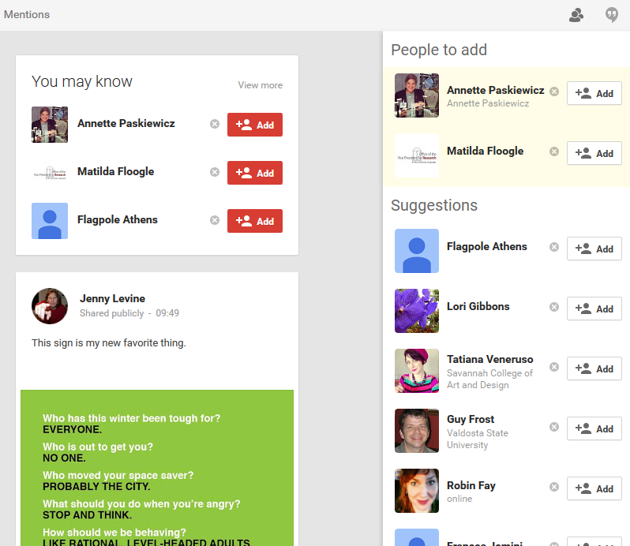

Slide 38
In fact... you can hang out from lots of different places

Slide 39
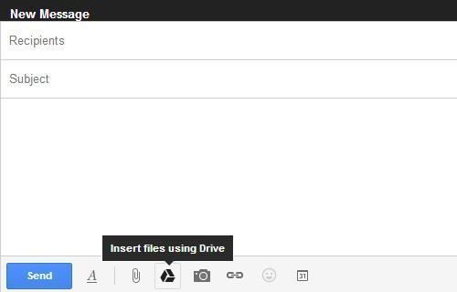
Finally, you can insert files from drive into an email.Let’s take a look at the Google search handout to explore advanced searching http://tinyurl.com/qhd4gzo

